Slide 1
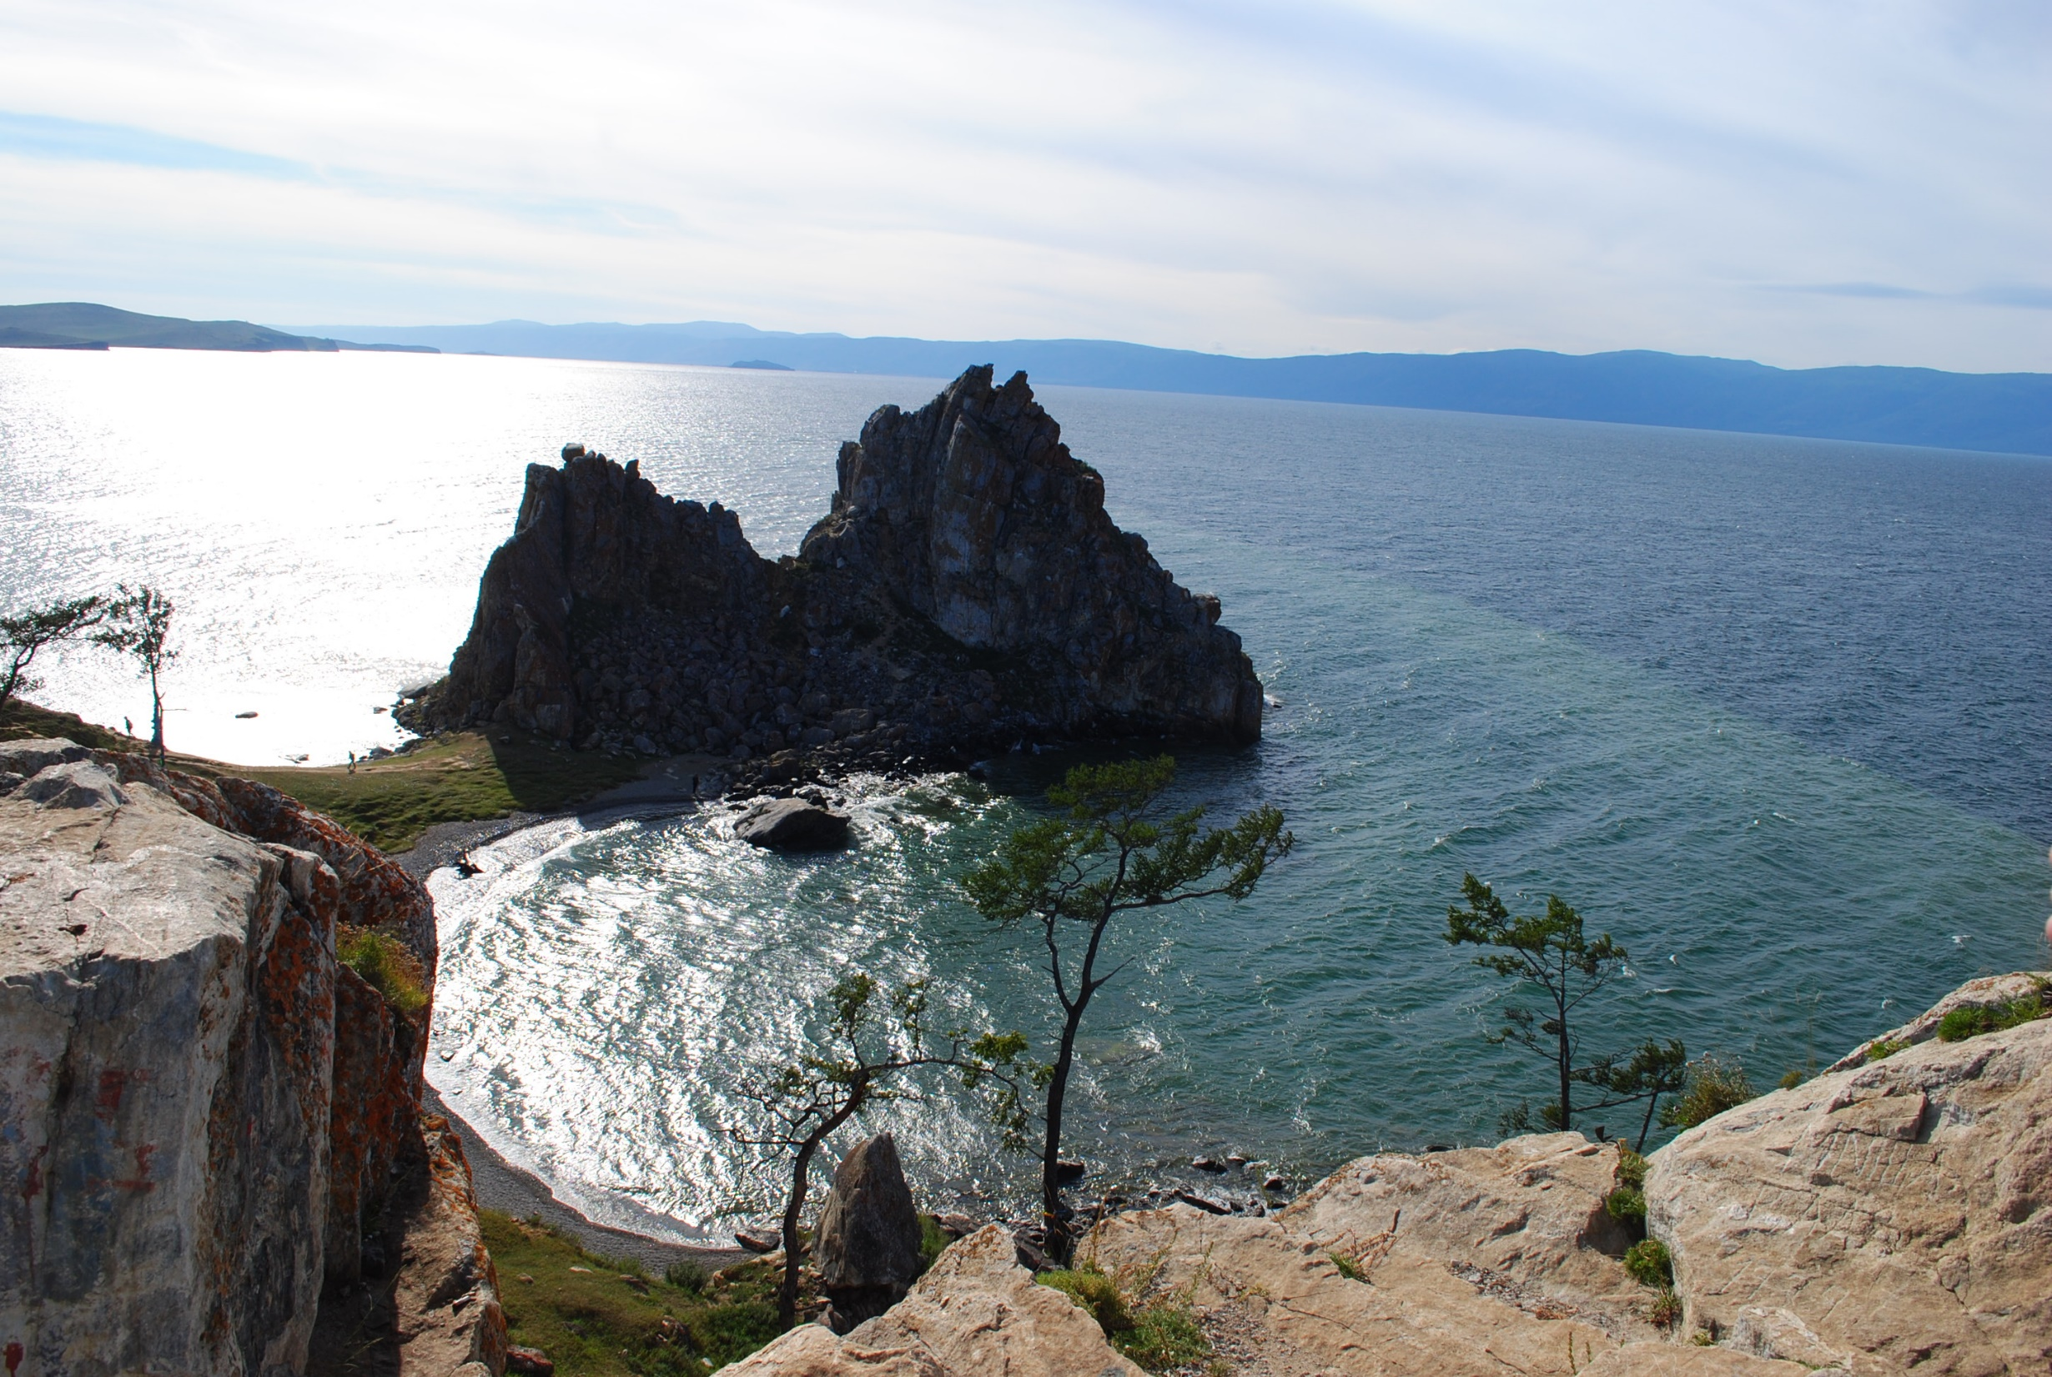
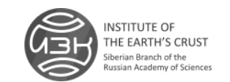
Institute of the Earth’s Crust, SB RAS: Proposals for scientific collaboration

Slide 2
DEPARTMENT OF GEOPHYSICAL RESEARCHES

Slide 3
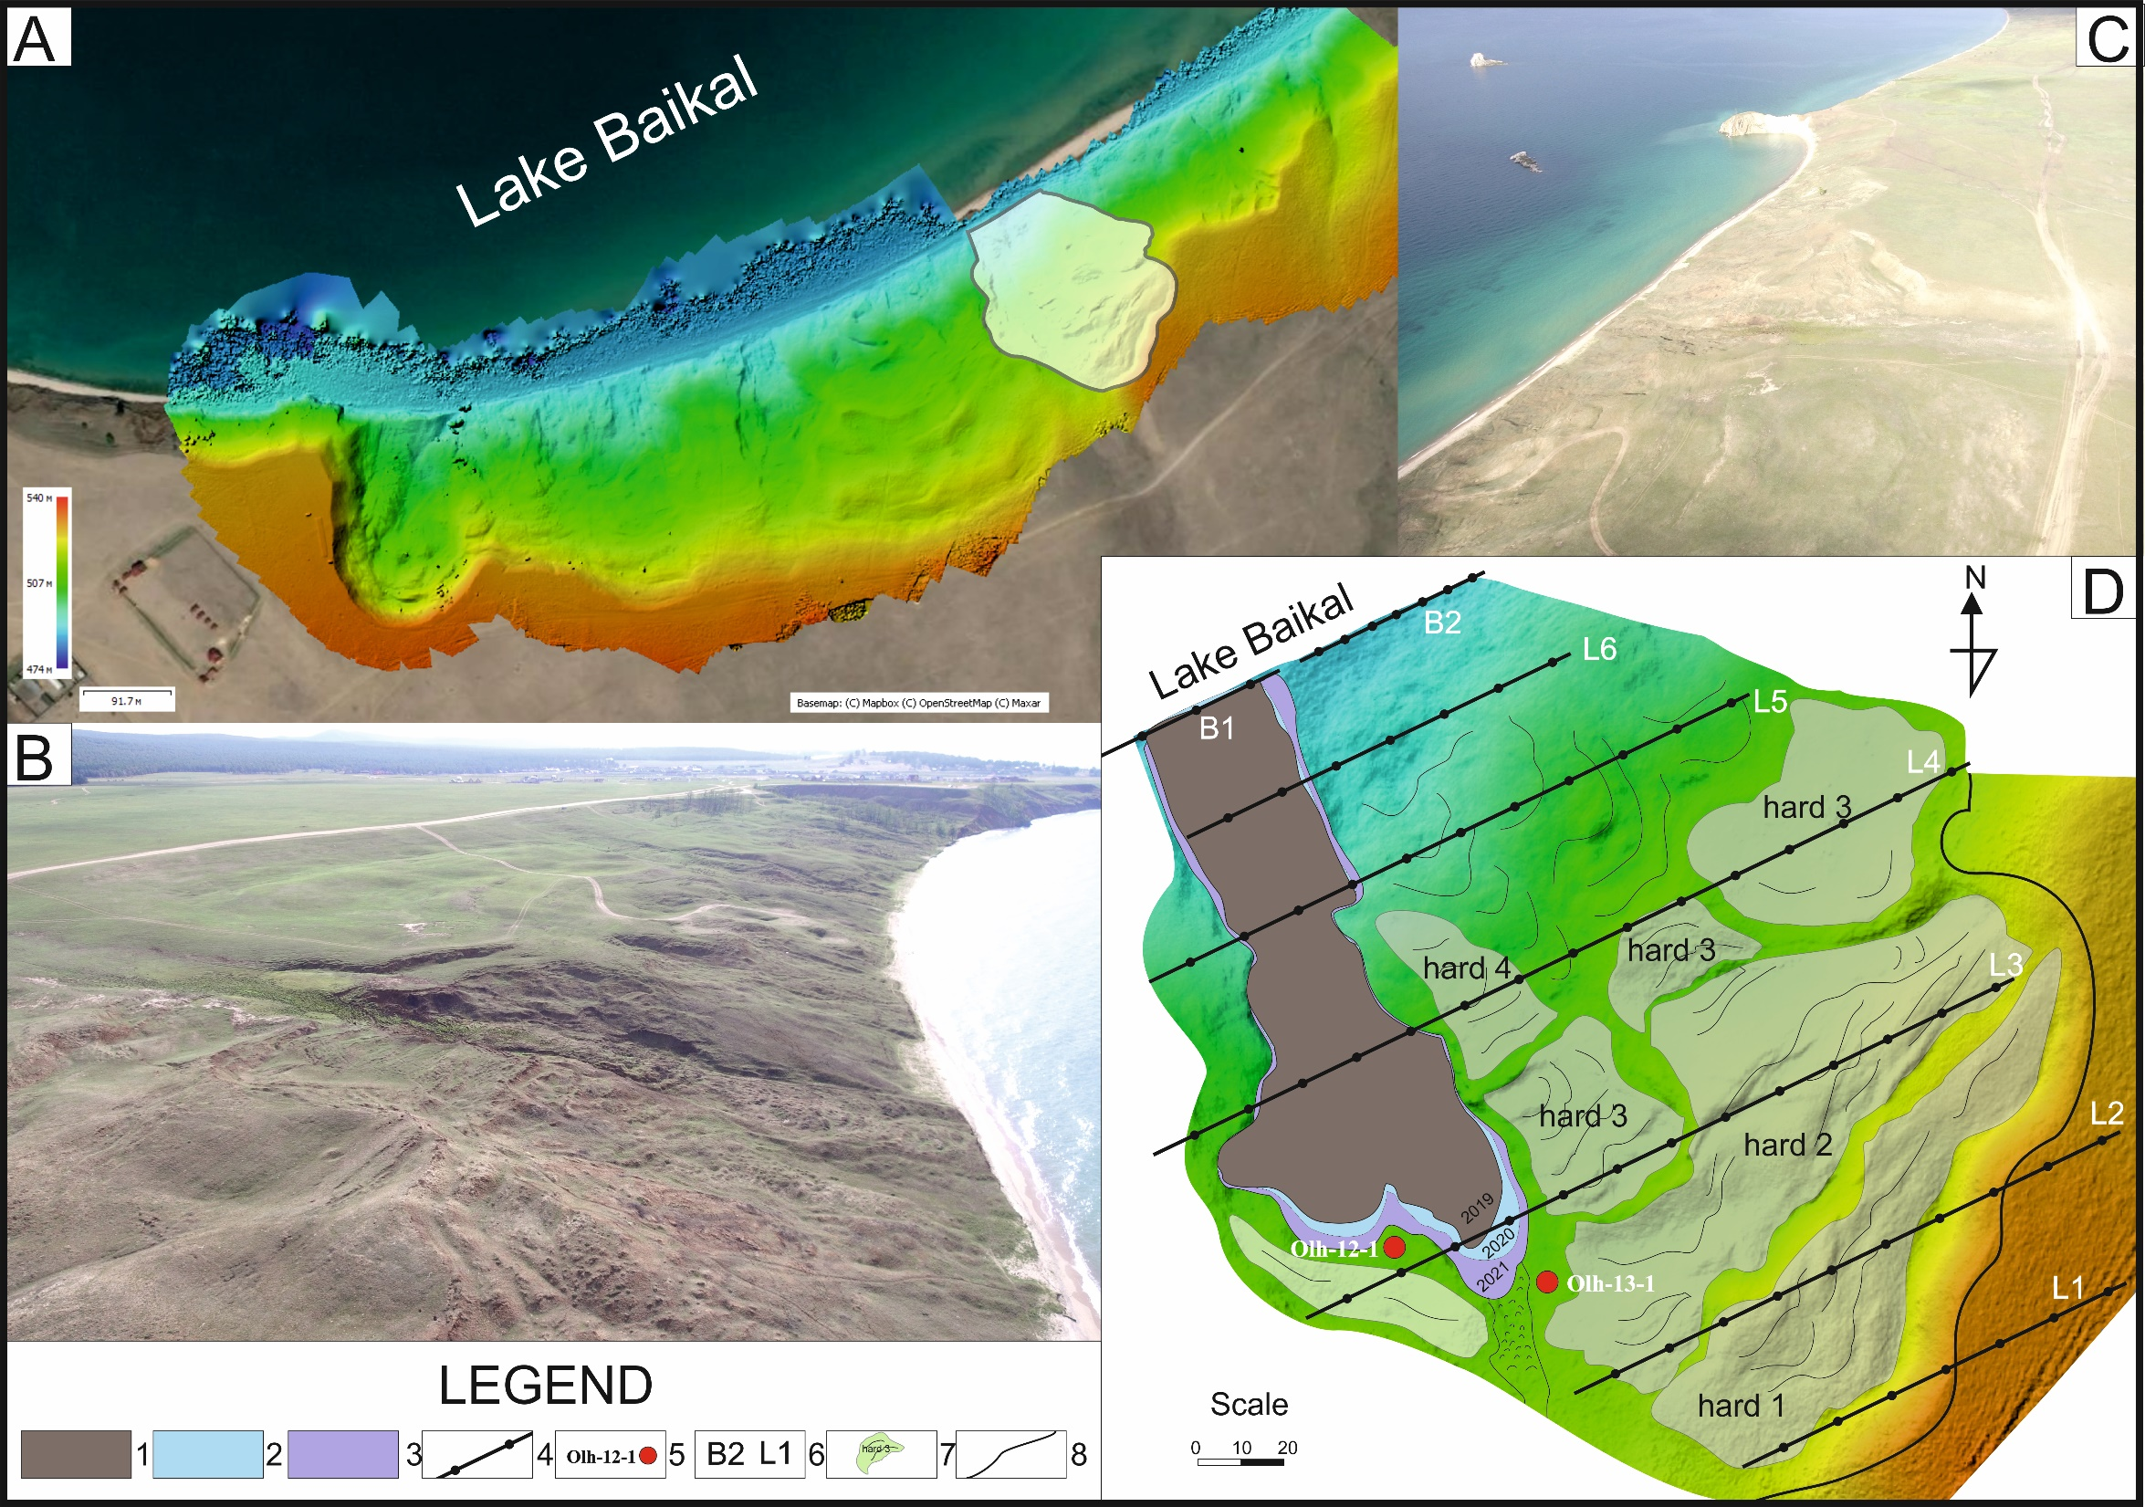
ENGINEERING GEOLOGY AND GEOECOLOGY DEPARTMENT
It is interesting to carry out an ecological and geochemical assessment of modern state of soils in the Baikal region
(Olkhon Island, Lake Baikal) under increasing anthropogenic impact. The chemical composition of soils is an important
indicator of environmental changes. There are two Databases of chemical composition of soils of catchment basins in
Olkhon Island.
The most complex problem is modeling transfer of hazardous elements, because the presence of significant contents of
heavy metals can cause negative toxic effects in coastal geosystems.
It gives rise the possibility of long-term geochemical
assessment of ecological conditions on the territory studied.
Also, we can modeling the occurred movement of
landslide material to the coastal zone of the lake.
Scheme of the study area. Legend: 1–3 – areas of modern sediment displacement during the period of 2019–2021; 4 – profiles for geochemical sampling; 5 – wells; 6 – geochemical profiles; 7 – landslide steps and blocks;
8 – landslide main scarp

Slide 4
ENGINEERING GEOLOGY AND GEOECOLOGY DEPARTMENT
Physical modeling of solifluction landslides in the coastal zone on the example of Olkhon Island, Lake Baikal.

